Slide 1

IST-736 Final Project
Building a Marvel Search Engine
Emilio Ramos Monzalvo
Joshua R Biggs-Bauer
Sharat Sripada

Slide 2
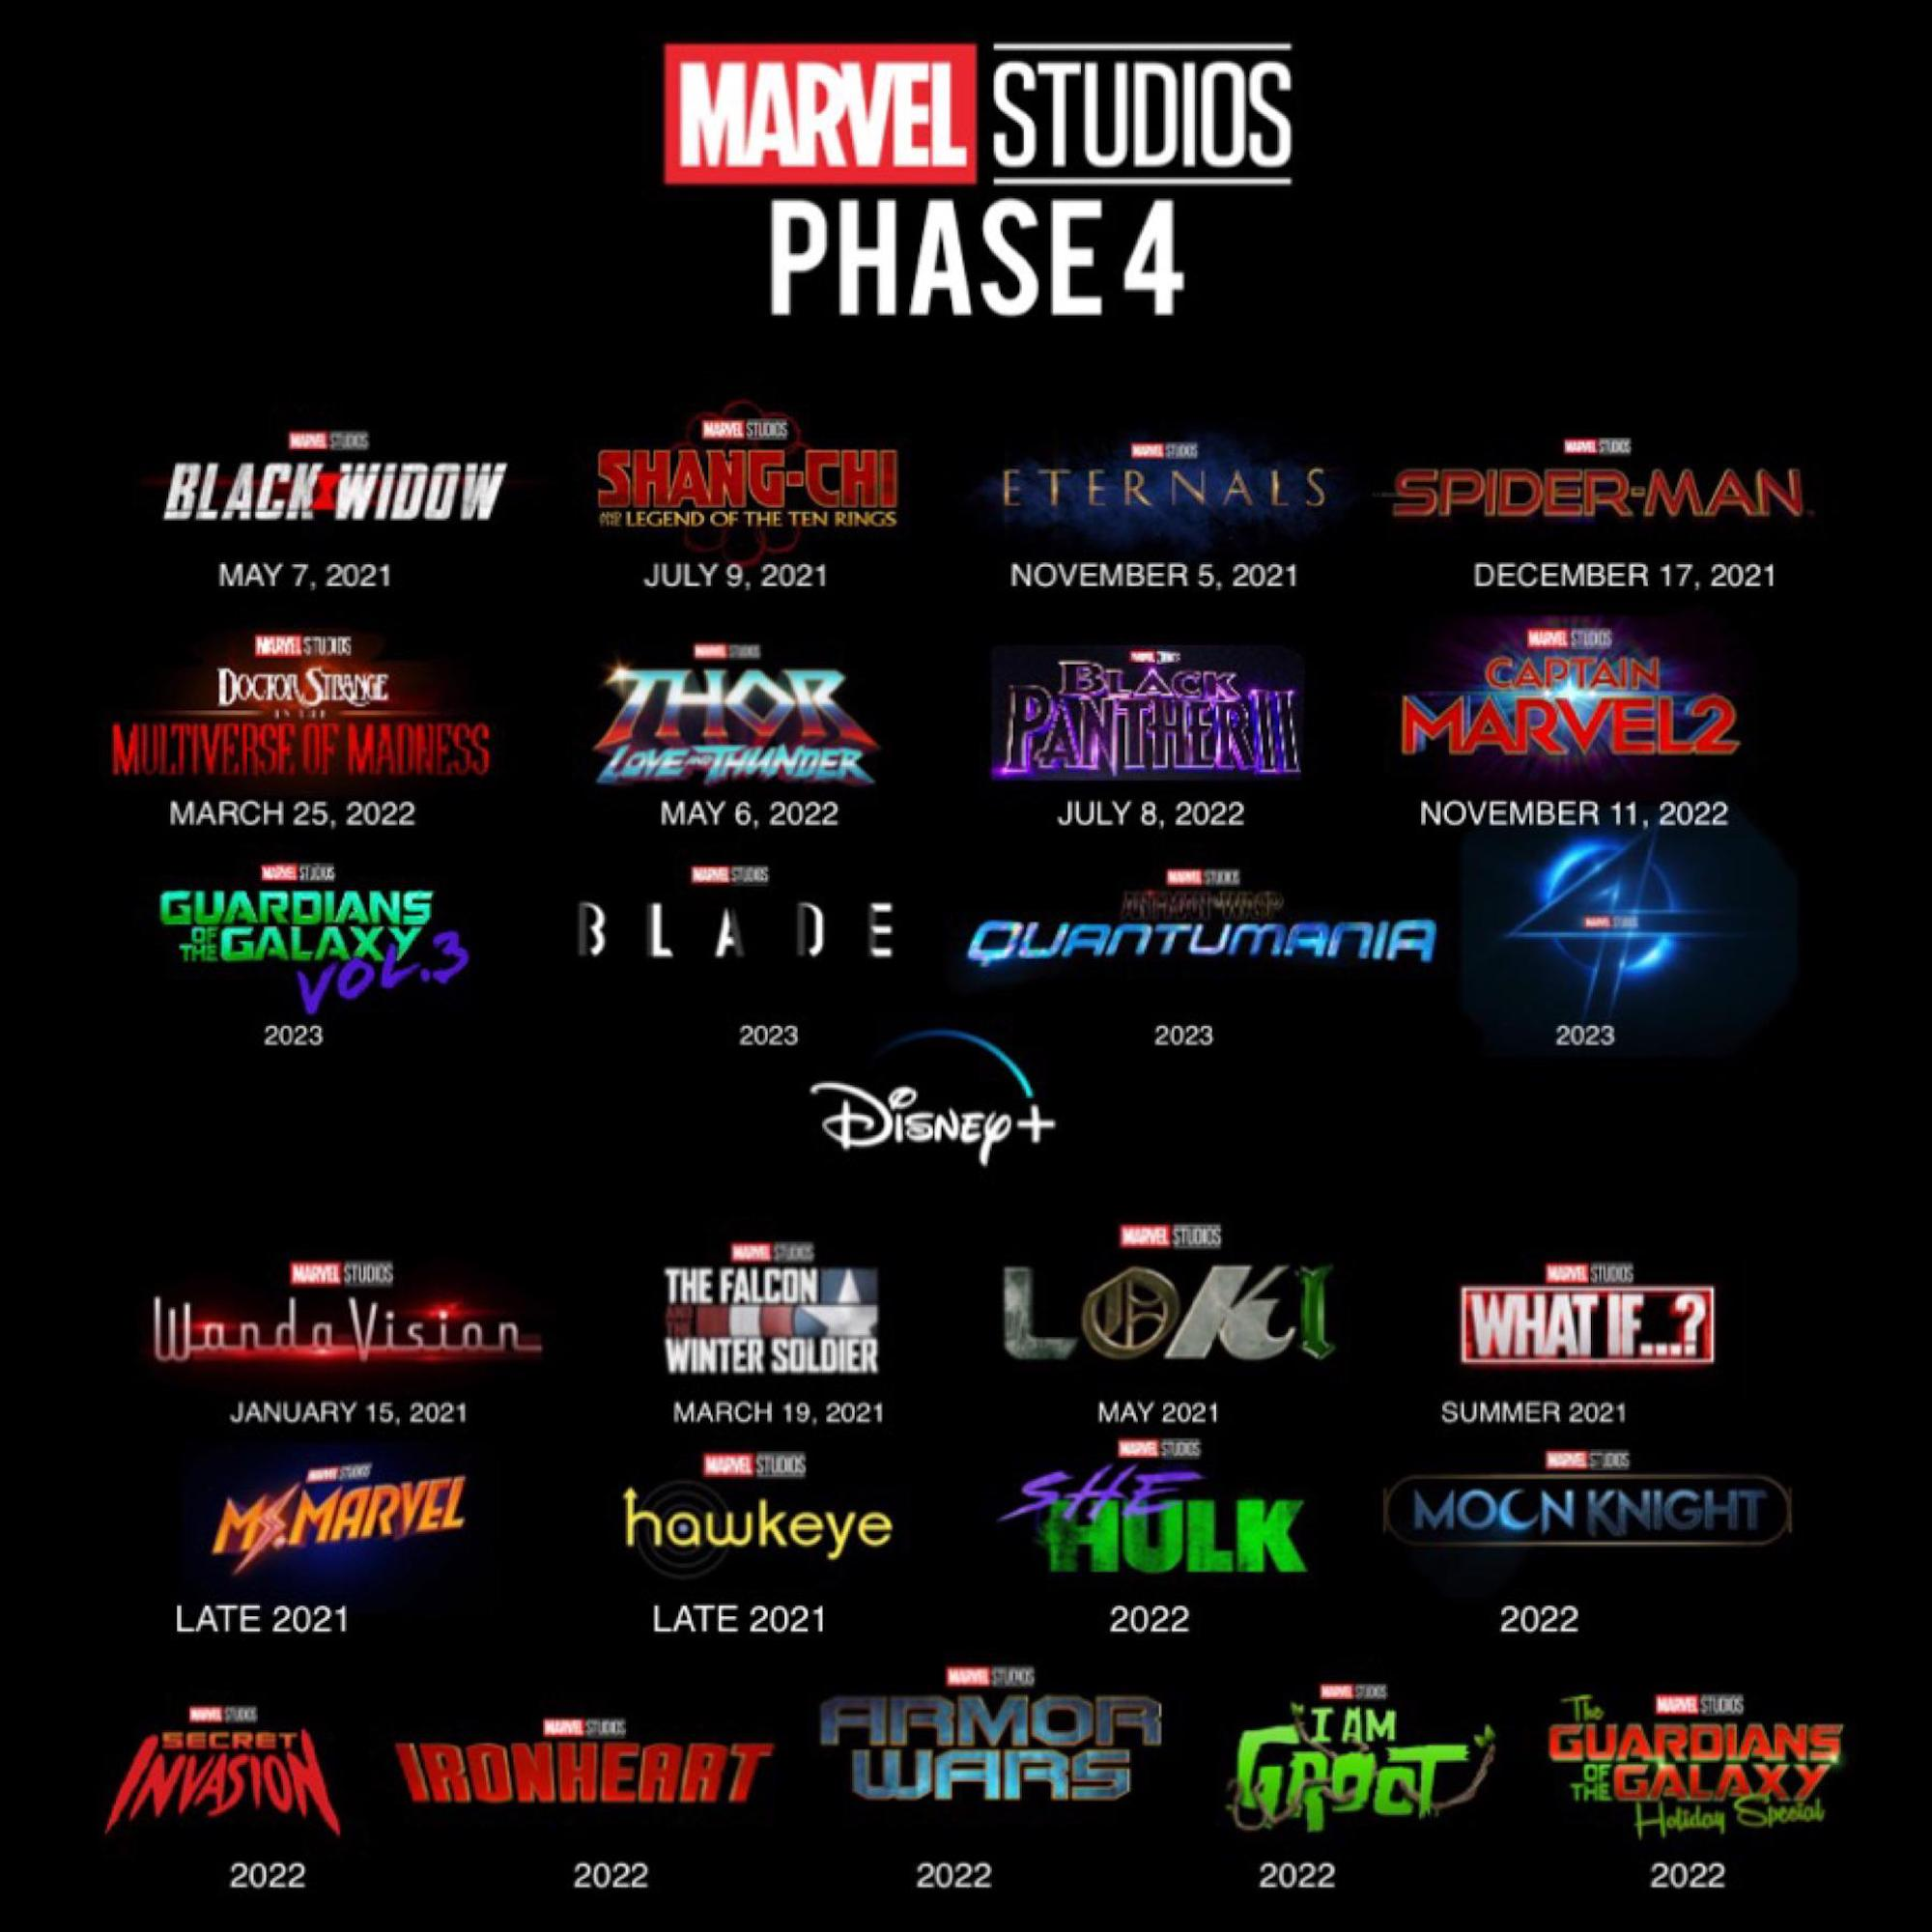
Marvel Cinematic Universe is getting too big
Problem Statement
The Infinity Saga (Phases 1-3) of the MCU, consisted of 23 movies which is would take more than 3000min to watch it all.
As Phase 4’s 25 TV shows and movies approach, how do we know which movies to pre-watch to get relevant information??

Slide 3


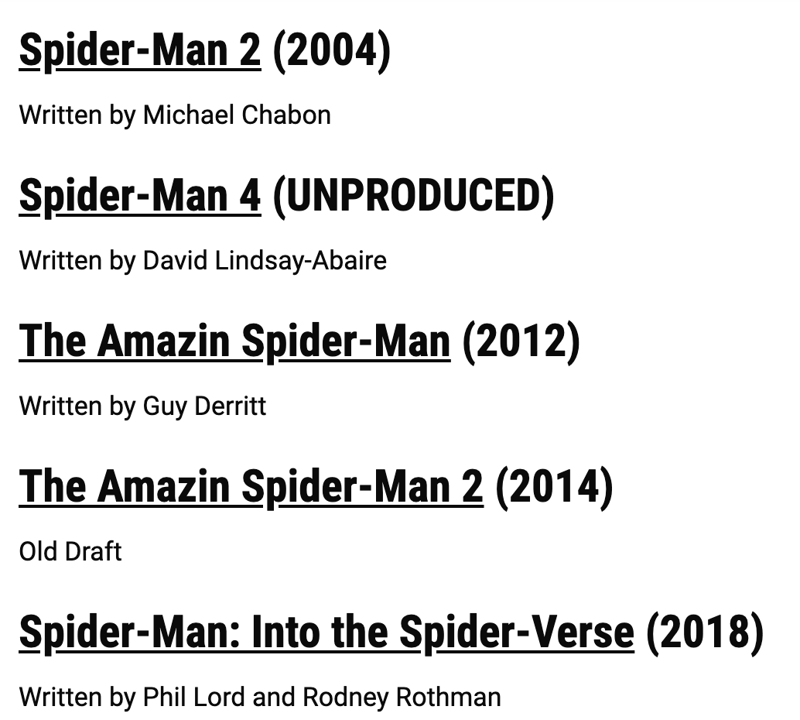
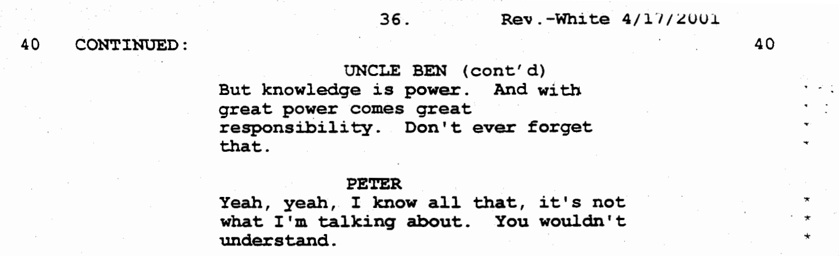
Finding Relevant MCU information through Movie Scripts
Proposed Solution
Build a model for a large text corpus of transcripts of Marvel movie screenplay – then using a search engine, given a query (like a dialogue, monologue, location or character) retrieve corresponding documents ranked in order of relevance.
The search engine will then help MCU fans, find a place in the MCU where they can learn more about a specific topic rather than rewatching all the movies.
Search Bar
With great power comes great responsibility
https://www.scriptslug.com/assets/scripts/spider-man-2002.pdf
Excerpt – Who said what..
Relevant Marvel movies

Slide 4
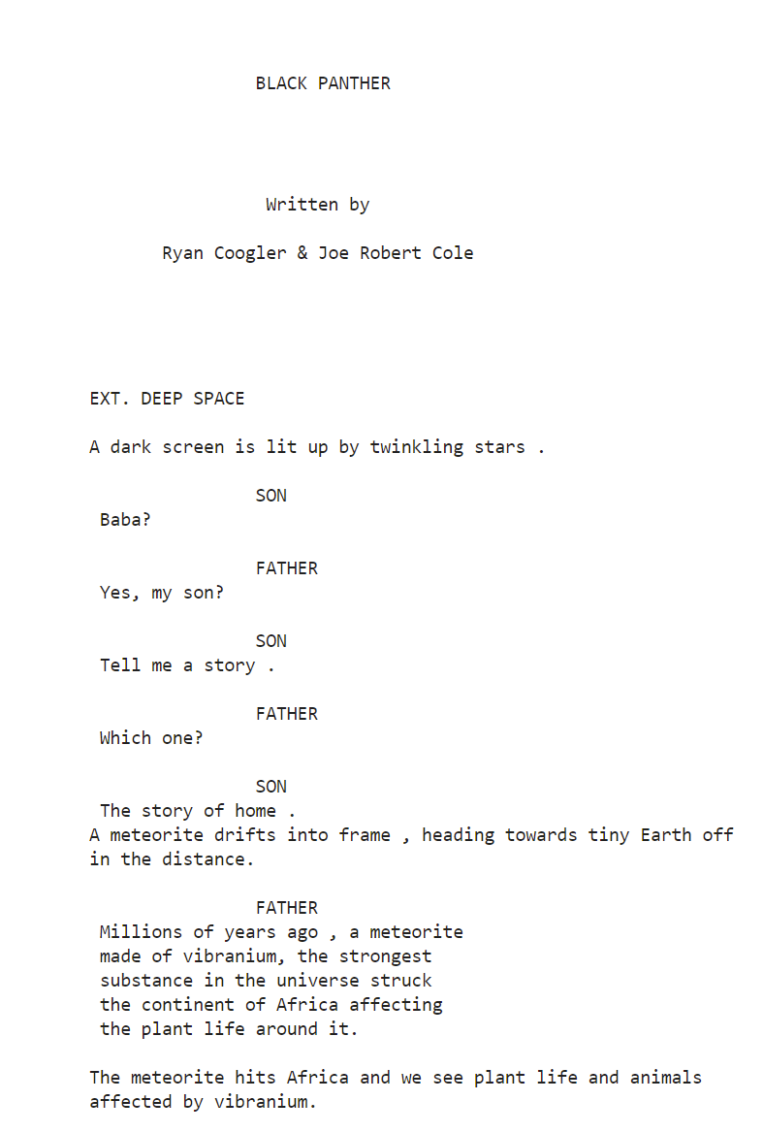
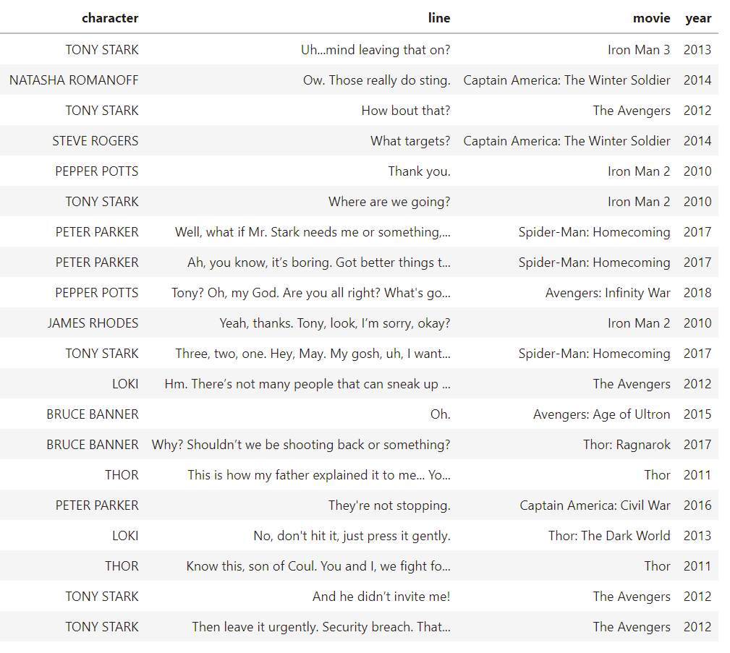
Finding Relevant MCU information through Movie Scripts
Text Mining Concepts
Scripts are not standardized. Scripts can come as pdfs or text files where each one might follow a different patter. Using text scraping and regex, the text should be standardized.
Raw Script PDF
Vectorized Script
Processing Script
Get important characters and their dialog.
Get setting and narration of script.
Remove un-important comments.
Clean up Text for modeling.

Slide 5
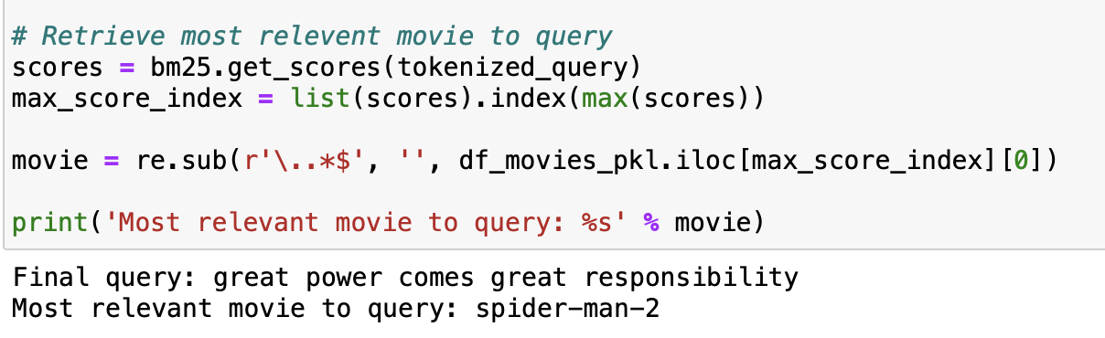
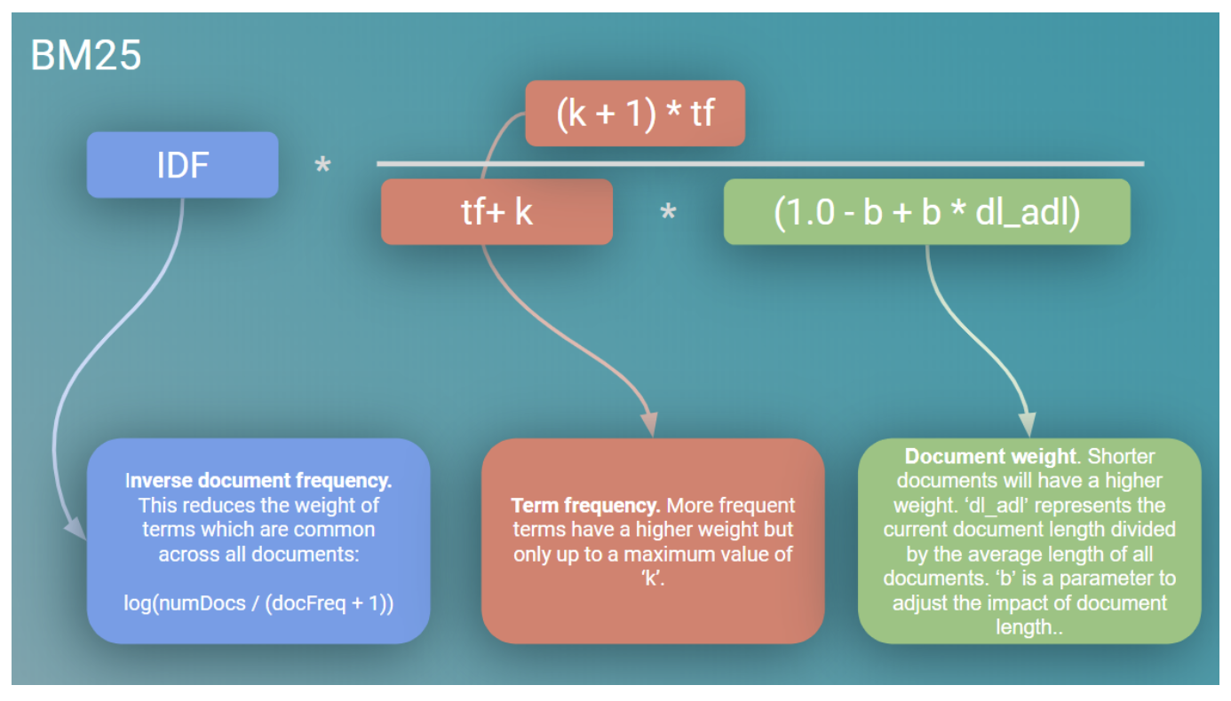
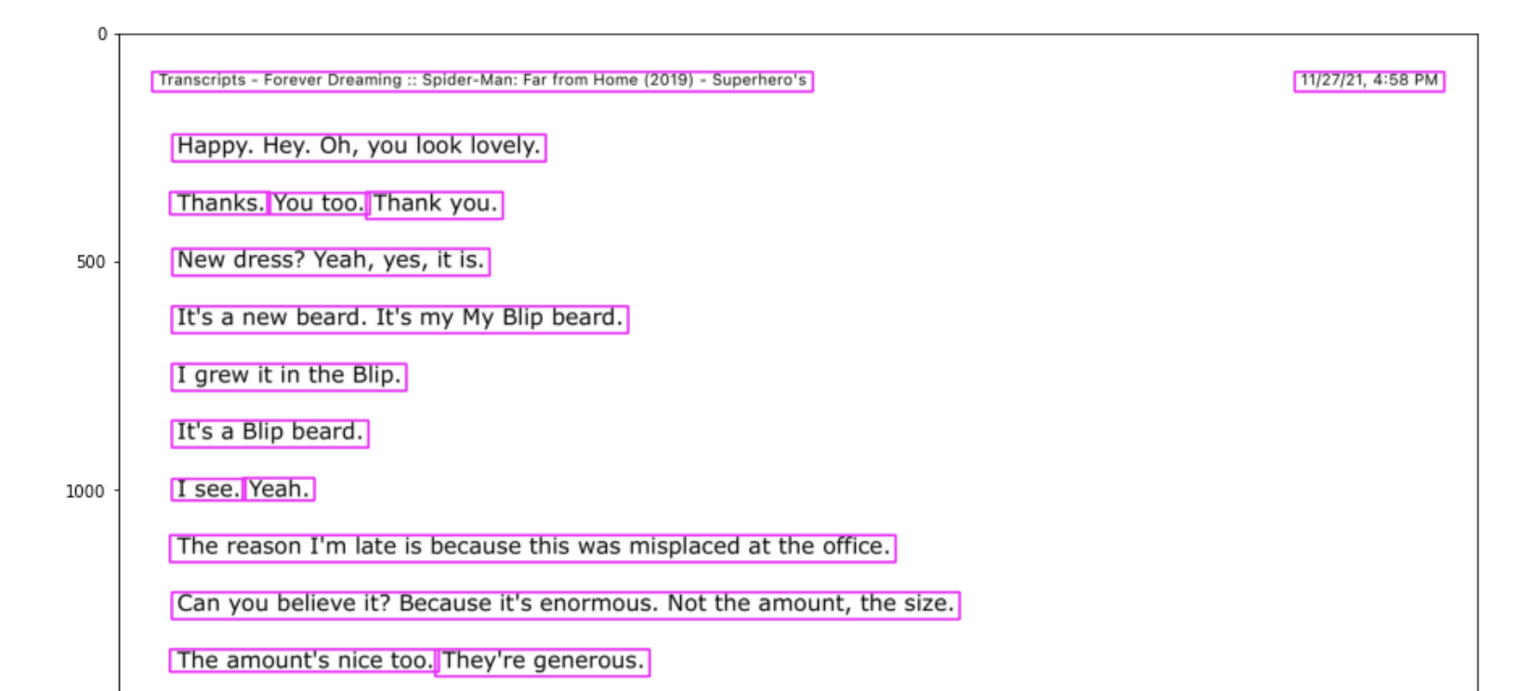
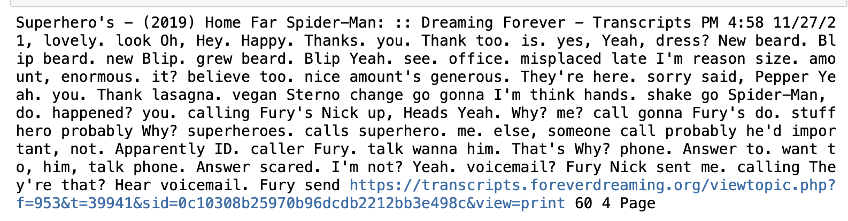
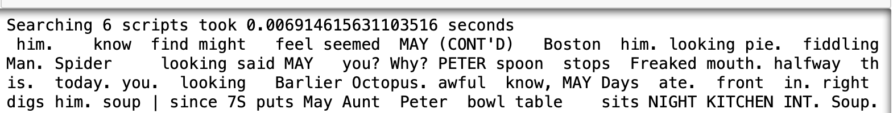
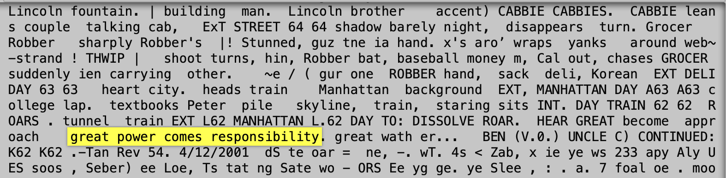
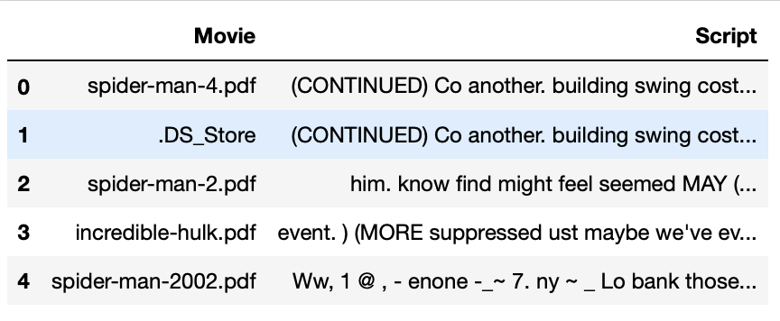
Best Match(BM)-25
Data preparation
Build Model
Search in Action!
Some scripts in raw format..
With great power comes great responsibility
Obtain data-set
Screenplay of Marvel movies in transcript
Organize text features with BM-25 vectorization + model
Results
Retrieve relevant movie
Use pdf2image, cv2, pytesseract libs to extract text from pdf
Filtered for stop-words, redundant digits etc.
Retrieve all texts with associations
Movie-Script DF
BM-25 is a bag-of-words retrieval function that ranks a set of documents based on query terms appearing in each document, regardless of the proximity within the document
Benefits of use
- Popularly used by search engines to estimate the relevance of documents to a given search query
- Highly efficient with refinements: Term Freq Saturation + Doc Length

Slide 6
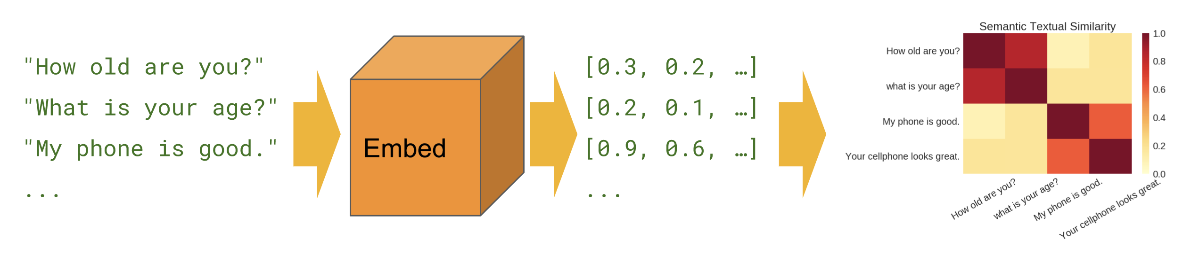
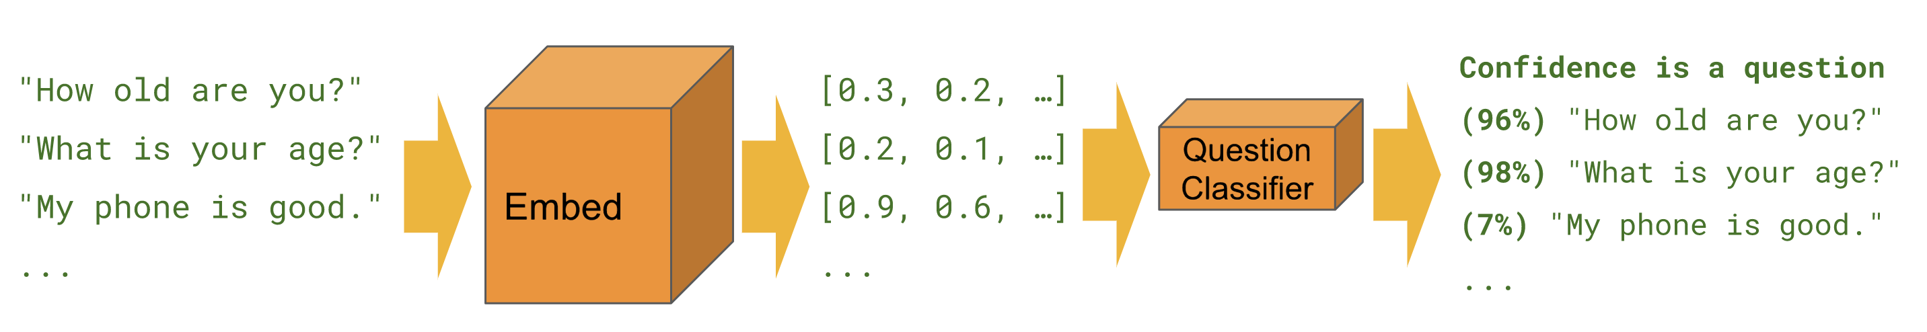
Google’s Universal Sentence Encoder (USE)
Benefits of USE
Text does not need to be pre-processed.
Semantic Similarity means the exact wording does not have to match a character’s line for it to match.
Complications of USE
Does not work well with dialog as it is not aware of which character said the line.
Pre-Processing is done in a Black Box.
Semantic Similarity: What lines does resemble similar meaning?
Two Main Applications:
Classification: What character is more likely to say this?
https://tfhub.dev/google/universal-sentence-encoder/4

Slide 7
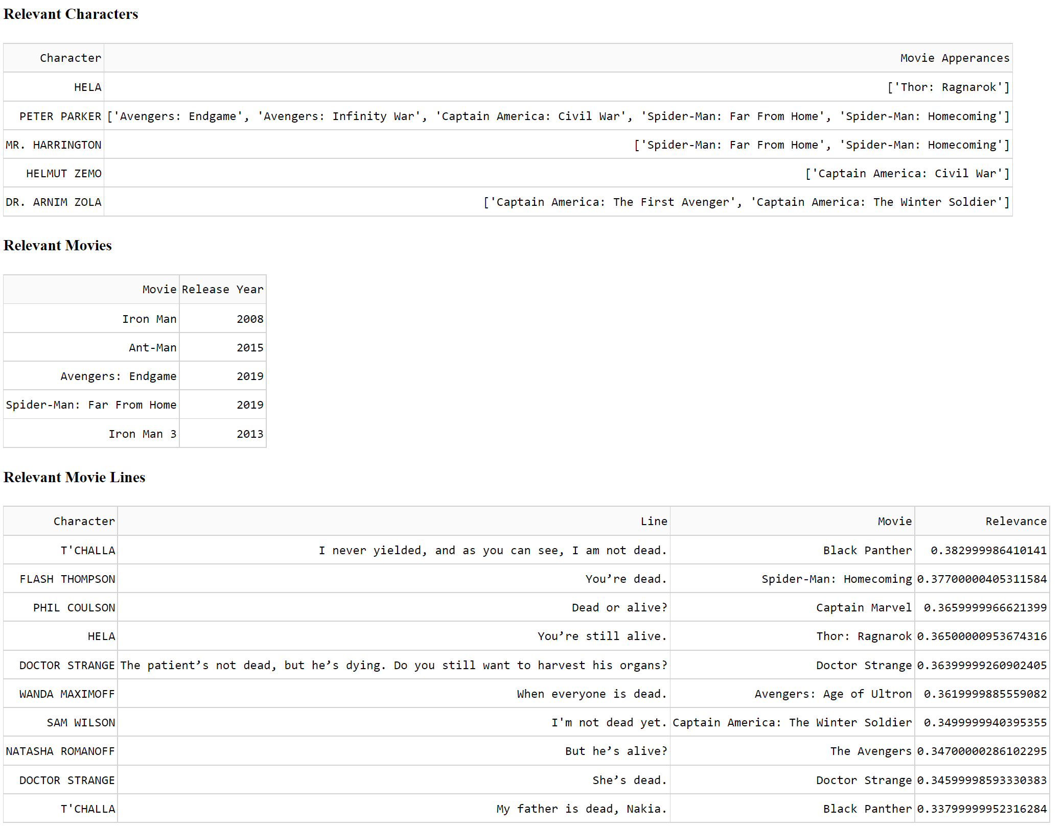
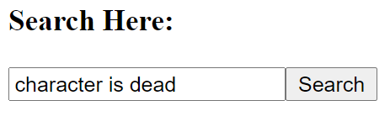
Demo
http://127.0.0.1:8050/

Slide 8
References
Scripts library: https://bulletproofscreenwriting.tv/marvel-studios-screenplays-download/
Extracting text from pdf: https://towardsdatascience.com/extracting-text-from-scanned-pdf-using-pytesseract-open-cv-cd670ee38052
How to build a search engine: https://towardsdatascience.com/how-to-build-a-search-engine-9f8ffa405eac
Also, introduction to BM25 algorithm

